Slide 1
Implementing GLOBIO
How to collect inputs, parameterize and run GLOBIO for Mato Grosso, Brazil
Justin Andrew Johnson – 2013-08-27

Slide 2
Presentation Outline
GLOBIO Model and Theory
NatCap Implementation of GLOBIO
New Additions, Revisions and Theoretical Advances over Base GLOBIO
Inputs and Model Calculation
Scripting Environment
Results
Unlike GLOBIO, we can show thresholds
(GLOBIO is only run once. We run several thousand times and compare scenarios)

Slide 3
GLOBIO Model and Theory
GLOBIO3 is a model built by UNEP that addresses:
The impacts of environmental drivers on MSA and their relative importance
Expected trends under various future scenarios
Likely effects of various policy response options.
Origin of GLOBIO3:
UNEP\GRID-Arendal and the Netherlands Environmental Assessment Agency (PBL) combined GLOBIO2 and the IMAGE-NCI approaches, together with some aspects of the MA approach into a single model

Slide 4
Background
GLOBIO is:
A set of equations linking environmental drivers and biodiversity impact
Best estimates of equation parameters drawn from literature review
Methodologies for processing required data
Based on Mean Species Abundance (MSA)
A value, 0 to 1, indicating the abundance of all species compared to their abundance in pristine or primary vegetation
The main difference between MSA and BII is that every hectare is given equal weight in MSA
MSA represents the average response of the total set of species belonging to an ecosystem.

Slide 5
1.) GLOBIO assess changes in MSA from “drivers”
UNEP drivers are:
land-use change and harvesting (mainly forestry)
atmospheric nitrogen deposition*
Fragmentation (patching)
climate change*
Infrastructure
Asterisks indicate drivers not included directly in our analysis
However, they can be included via creation of alternate land use scenario maps
Our main driver: Soy Extensification
We create 400 future scenarios of 1%, 2% … 400% more soy production according to a extensification probability assignment function
TO DO: UPDATE FOR 6 RICH-CODE SCENARIOS

Slide 6
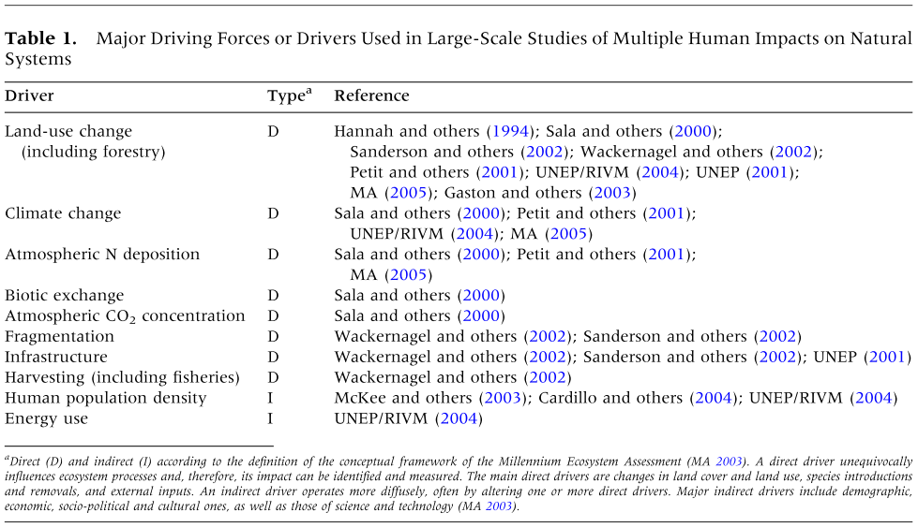
UNEP’s Drivers and Literature Sources

Slide 7
GLOBIO Method
Identify MSA(LU)
UNEP Approach: Convert
‘Cultivated and managed areas’ was divided into ‘intensive agriculture’ and ‘low input agriculture’ based on estimates of the distribution of intensive and low-input agriculture in different regions of the world, from Dixon and others (2001).
We assumed 100% intensive agriculture in regions not covered by these estimates (Table 2). ‘Mosaic of cropland and forest,’ was treated as a 50–50% mixture of ‘low input agriculture’ and ‘lightly used forest’.

Slide 8
Calculating Overall MSA
For each driver X a MSA X map is calculated by applying the cause–effect relationships to the appropriate input map. In the no-interaction case, for each IMAGE grid cell, GLOBIO3 calculates the overall MSA I value by multiplying the individual MSA X maps derived from the relationships for each driver:
where i is a grid cell, MSA i is the overall value for grid cell i, MSA Xi is the relative mean species abundance corresponding to the drivers LU (land cover/land use), N (atmospheric N deposition), I (infrastructural development), F (fragmentation), and CC (climate change).

Slide 9

Converting Gridcells to Regions
As the area of land within each IMAGE grid cell is not equal, the MSA r of a region is the area weighted mean of MSA i values of all relevant grid cells.
where A i is the land area of grid cell i.

Slide 10
2.) NatCap Implementation of GLOBIO

Slide 11
Model Flow Blue = input, White = Function (MAKE BIGGER DEAL OUT OF THIS, SHOW IS FROM PAPER, Green = Intermediate data
Potential Vegetation
LULC
(MODIS)
Broad LULC
(temp.)
GLOBIO LULC
MSA(LU)
Input to GLOBIO Broad Correspondence CSV
Yield Gap Totals
Distance from Infrastructure to MSA(I)
MSA
Infrastructure
MSA(I)
Frag Tool?
LULC
(MODIS)
Human-Made vs. Natural LULC
Patchsize to MSA(F) function
Define Habitat Patches
MSA(F)
Infrastructure
(that splits patches)

Slide 12

Step 1: Create $MSA_{LU}$ from LULC data
UNEP Approach:
The data for land cover and/or land use—and changes therein—come from the IMAGE model at a 0.5 by 0.5 deg. Resolution.
To increase the spatial detail within each IMAGE grid cell, we calculated the proportion of each type of land cover and/or land use from the Global Land Cover 2000 (GLC2000) map, representing the year 2000
GLC2000 distinguishes 10 forest classes, 5 classes of low vegetation (grasslands and scrublands), 3 cultivated land classes, ice and snow, bare areas and artiﬁcial surfaces (Bartholome and others 2004). To translate these classes to the land-use categories considered here we ﬁrst aggregated the GLC2000 classes into broader land-cover classes (Table 4).

Slide 13
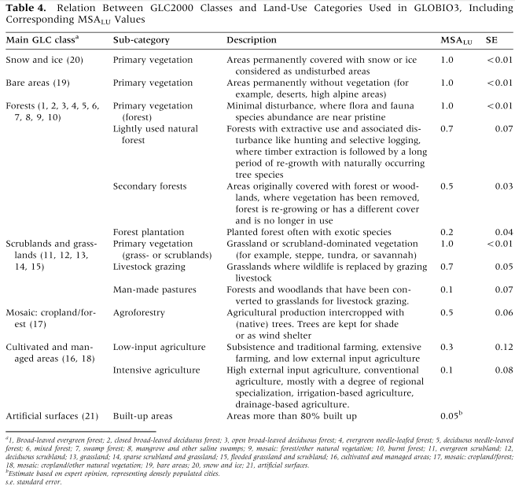
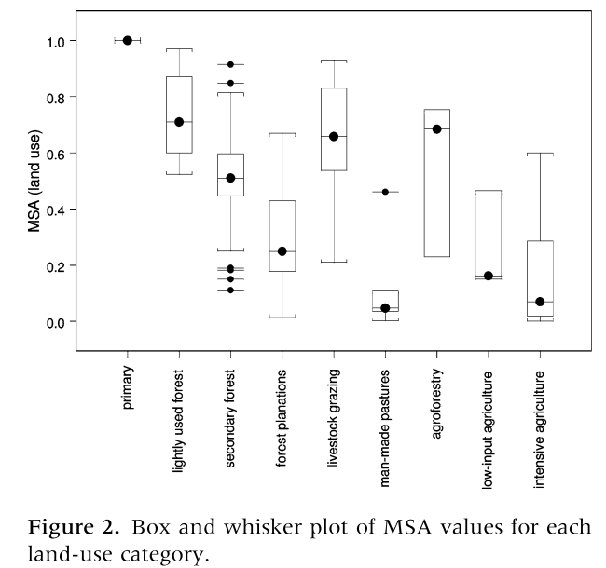
Data on GLC2000 and GLOBIO Parameters

Slide 14
Globio LULC Names and Parameters with effect on MSA
GLOBIO LULC Names | GLOBIO LULC Values | MSA(LU) | SE
Primary vegetation | 1 | 1 | 0.01
Lightly used natural forest | 2 | 0.7 | 0.07
Secondary forests | 3 | 0.5 | 0.03
Forest plantation | 4 | 0.2 | 0.04
Livestock grazing | 5 | 0.7 | 0.05
Man-made pastures | 6 | 0.1 | 0.07
Agroforestry | 7 | 0.5 | 0.06
Low-input agriculture | 8 | 0.3 | 0.12
Intensive Agriculture | 9 | 0.1 | 0.08
Built-up areas | 10 | 0.05 | 0

Slide 15
Step 1.1: Create Broad LULC (temp) map
GLC2000 to GLOBIO Mapping (multiple categories represent broad-category)
GLC LULC Names | GLC LULC Values | Convert to which GLOBIO Class?
Tree Cover, broadleaved, evergreen LCCS >15% tree cover, tree height >3m | 1 | 1,2,3
Tree Cover, broadleaved, deciduous, closed | 2 | 1,2,3
Tree Cover, broadleaved, deciduous, open (open 15-40% tree cover) | 3 | 1,2,3
Tree Cover, needle-leaved, evergreen | 4 | 1,2,3
 | 5 | 1,2,3
 | 6 | 1,2,3
Tree Cover, regularly flooded, fresh water (& brackish) | 7 | 1,2,3
Tree Cover, regularly flooded, saline water, (daily variation of water level) | 8 | 1,2,3
Mosaic: Tree cover / Other natural vegetation | 9 | 1,2,3
Tree Cover, burnt | 10 | 1,2,3
Shrub Cover, closed-open, evergreen | 11 | 1,4,5,6
Shrub Cover, closed-open, deciduous | 12 | 1,4,5,6
Herbaceous Cover, closed-open | 13 | 1,4,5,6
Sparse Herbaceous or sparse Shrub Cover | 14 | 1,4,5,6
Regularly flooded Shrub and/or Herbaceous Cover | 15 | 1,4,5,6
Cultivated and managed areas (i) terrestrial; (ii) aquatic (=flooded during cultivation), and under terrestrial: (iii) tree crop & shrubs (perennial), (iv) herbaceous crops (annual), non-irrigated, (v) herbaceous crops (annual), irrigated) | 16 | 8,9
Mosaic: Cropland / Tree Cover / Other natural vegetation | 17 | 7
Mosaic: Cropland / Shrub or Grass Cover | 18 | 8,9
Bare Areas | 19 | 1
Water Bodies (natural & artificial) | 20 | 1
Snow and Ice (natural & artificial) | 21 | 1
Artificial Surfaces and associated areas | 22 | 10

Slide 16
NatCap Approach to Step 1.1
We use Modis LULC data instead of GLC2000
So we need a new lookup table, presented here
Create new Broad GLOBIO LULC Classes
LULC Values 130-132 are temporary broad categories, which will be broken down into subcategories momentarily
Modis LULC Class | Modis LULC Value | Convert to which GLOBIO Class(s)? | BroadCode (temporary step before splitting into subclasses)
Water | 0 | 0 | 0
Evergreen Needleleaf forest | 1 | 1,2,3,7 | 130
Evergreen Broadleaf forest | 2 | 1,2,3,7 | 130
Deciduous Needleleaf forest | 3 | 1,2,3,7 | 130
Deciduous Broadleaf forest | 4 | 1,2,3,7 | 130
Mixed forest | 5 | 1,2,3,7 | 130
Closed shrublands/ Cerrado | 6 | 1,4,5,6 | 131
Open shrublands | 7 | 1,4,5,6 | 131
Woody savannas | 8 | 1,4,5,6 | 131
Savannas | 9 | 1,4,5,6 | 131
Grasslands | 10 | 1,4,5,6 | 131
Croplands/Perennial | 12 | 8,9 | 132
Urban and built-up | 13 | 10 | 10
Barren or sparsely vegetated | 16 | 1 | 1
Soybean Croplands | 120 | 8,9 | 132
(Red text indicates steps in the GLOBIO Helper Tool)

Slide 17
Prospectus aobut future research topics
Me, lisa, guy, sarah, Isabela, becky, rich as authors

Slide 18
Step 1.2: Identify High vs. Low Intensity Agriculture
NatCap Approach:
Use EarthStat Yield Gap Per Ha Yield data and a User Defined Threshold to spilt Agricultural Land into high and low input
I believe this approach is much superior to theirs, though to be fair, they did not say how exactly they did it.
to distinguish between low-input agriculture and intensive agriculture, we can apply a dataset developed by Foley et al. 2011 (LINK), that maps yield gaps for all major commodity crops globally. This methodology compares agricultural production in similar climates (based on precipitation and growing degree days) and rates crop yield in different regions according to the maximum yields attained for its particular climate. The difference between actual and maximum attainable yield is defined as the “yield gap.” We will use these yield gaps as an indicator of agricultural intensity, because while many different forms of management can boost yields, Mueller et al. (2012) found that fertilizer application and irrigation explained the vast majority of the variance in these yield gaps. We therefore consider all agriculture with less than a certain percent yield gap (experimenting initially with 15%, 25%, 35%) to be intensified, and the remainder to be low-input agriculture. The assignment of the percent of yield gap that demarcates intensification is somewhat arbitrary and should be tested to determine the impact on the overall results.

Slide 19
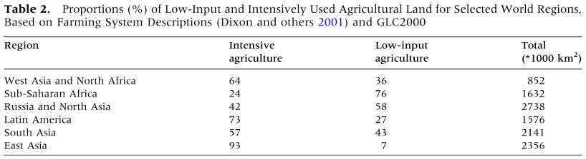
UNEP Parameters for Intensity Classes

Slide 20
Step 1.3: Split Scrublands and Grasslands into “pristine”, “grazing” and “pasture”
UNEP Approach
‘Scrublands and grasslands’ were divided into ‘pristine vegetations,’ ‘livestock grazing areas,’ and ‘man-made pastures’.
‘‘Livestock grazing areas’ were estimated by IMAGE for current and future years and distributed, proportionally, to all GLC2000 classes containing low vegetation.
‘Man-made pastures’ were assigned to the GLC2000 class of ‘herbaceous cover’ if found in originally forested areas according to the potential vegetation map generated by IMAGE (based on the BIOME model, Prentice and others 1992).
NatCap Approach:
to distinguish between native grasslands, grazing landscapes, and man-made pastures (deforested areas used for pasture), we compare Foley et al. (XXXX) potential vegetation map (LINK) with the MODIS land-cover data. If a particular pixel is supposed to be forest according to the potential vegetation map, but is actually listed as grassland in MODIS, we will reclassify this as “man-made pasture,” since this is likely forest that has been cleared for grazing. If a pixel is supposed to be grassland according to the potential vegetation map and is indeed listed as grassland in the MODIS data, we will then use a separate dataset developed by Ramankutty et al. (XXXX, LINK) on proportional pasture area at 5 min (10 km) resolution. We cannot determine from this data which pixels at the finer resolution of the MODIS data (463 m) are grazed, but we can approximate this by randomly assigning the proportional number of pixels to either “livestock grazing” (based on proportional area of pasture) or “grassland primary vegetation” (1 – proportional area of pasture).

Slide 21
Step 1.4: Identify ‘lightly used,’ ‘secondary,’ and ‘forest plantations’ forests
UNEP Approach:
we assigned the land-use categories ‘lightly used forest,’ ‘secondary forest,’ and ‘forest plantations’ to forest classes of GLC2000.
We used national data on forest use from FAO (2001) and assigned the derived fractions for each region, proportionally, to all grid cells that contain one or more GLC2000 forest classes (Table 3).
Bare areas are considered to be areas of primary vegetation if the potential vegetation is ice, snow, tundra, or desert, according to the BIOME model.
Scrub classes are considered to be secondary vegetation if the potential vegetation is forest, except for boreal forests, where scrub vegetation is assumed to be part of the natural ecosystem.
NatCap Approach:
to distinguish between pristine forest, forest with some extractive use, and secondary (replanted) forests we can apply the fragmentation tool (Appendix B) to forest cover and assign different use categories based on FFQI. To determine the FFQI threshold that separates pristine forest from secondary or extractive forest, we can apply the tool first to a landscape where these uses are known and run a preliminary analysis investigating the relationship between FFQI and forests of different harvest pressure. If no general relationship can be derived, we can assume the most conservative case, that all forest is pristine forest.
I WILL USE NEAR HUMAN INFLUENCE, but this ignores the FFQI effect. But, we’re gonna use their fragmentation method, but

Slide 22
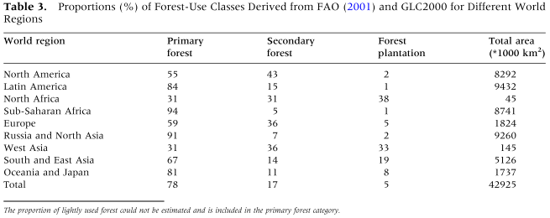
UNEP Assignment Proportions

Slide 23

Step 2: Create $MSA_{F}$ (fragmentation)
The relationship between MSA and patch size was built upon data on the minimum area requirement of animal species deﬁned as the area needed to support at least a minimum viable population (Verboom and others 2007).
The proportion of species for which a certain area is sufﬁcient for their MVP is calculated and considered a proxy for MSA.
Patch sizes were calculated by ﬁrst reclassifying GLC2000 into two classes: man-made land (including croplands and urban areas) and natural land, all the rest.
An overlay with the main roads derived from the infrastructural map resulted in a map of patches of natural areas.

Slide 24
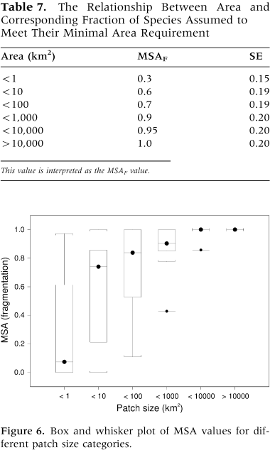
Plotsize Params
edge_distance = scipy.ndimage.morphology.distance_transform_edt( forest_existance) * cell_size

Slide 25

Step 3: Create $MSA_{I}$ (infrastructure)
A global map of linear infrastructure, containing roads, railroads, power lines, and pipe lines, was derived from the Digital Chart of the World (DCW) database (DMA 1992). Buffers of different width, varying between biomes, were calculated and assigned to impact zones according to UNEP/RIVM (2004). The impact zones were summarized at 0.5 deg. grid resolution.

Slide 26
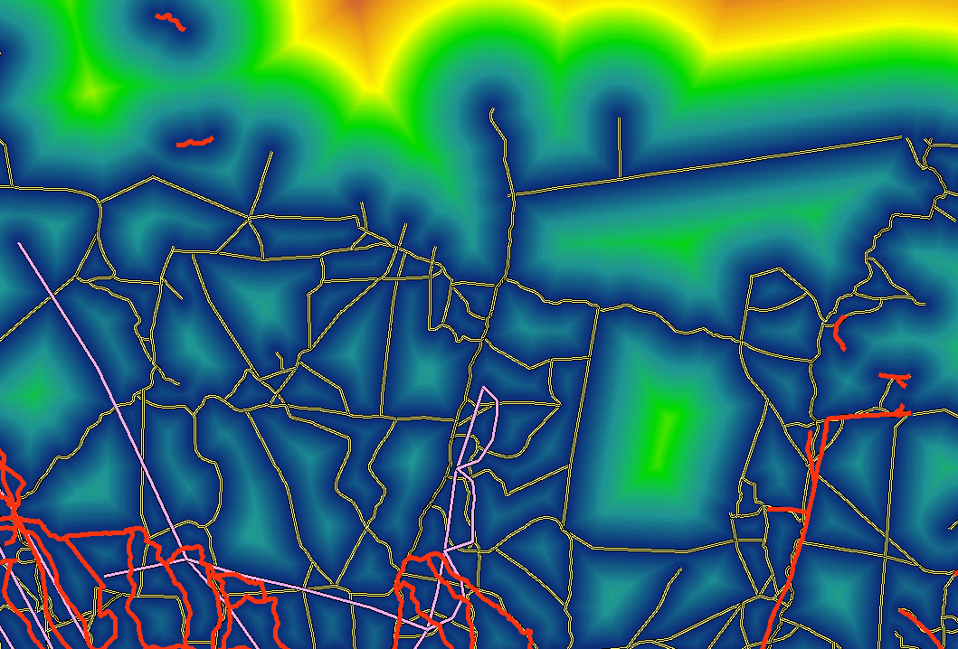

Slide 27
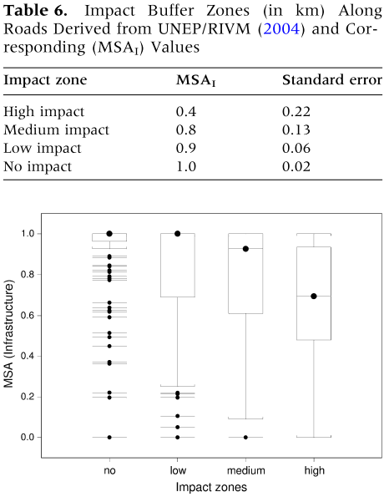
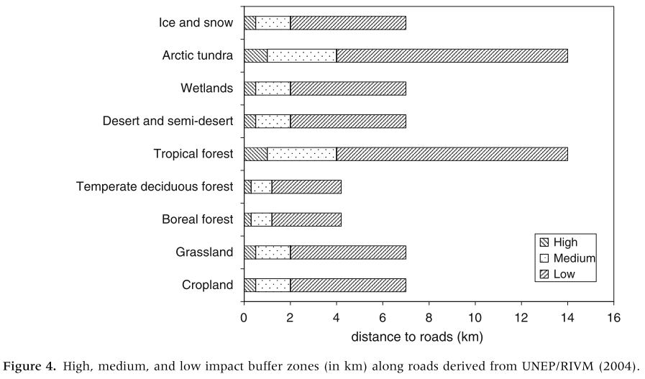
Infrastructure Params

Slide 28
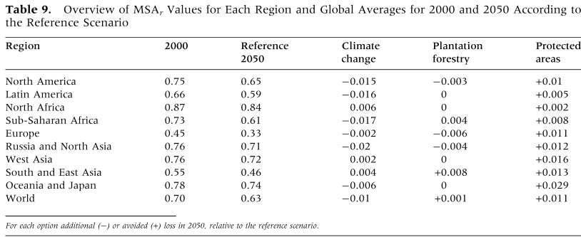
Results
As a result, global MSA is projected to decrease from about 0.70 in 2000, to about 0.63 by 2050.
0.01 of global MSA is equivalent to the conversion of 1.3 million km2 (an area the size of Peru or Chad)

Slide 29
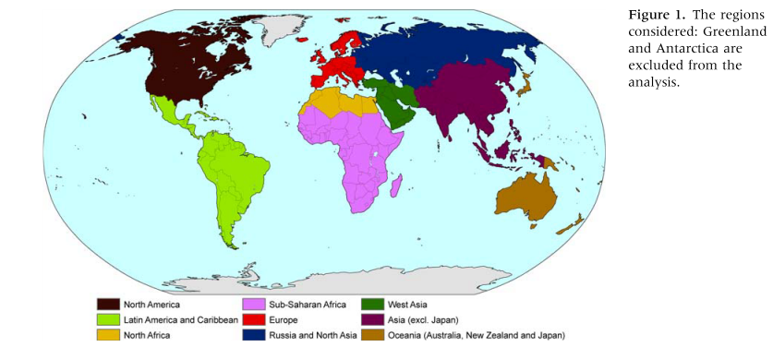
UNEP’s Regions

Slide 30
Appendix

Slide 31
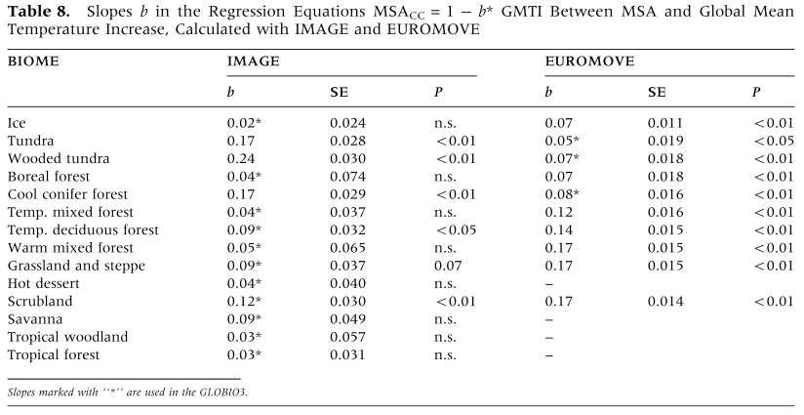
Climate Change Params

Slide 32
How Globio creates future scenarios
For future scenarios, we used calculations of future timber demands to obtain the areas needed to produce the timber, and proportionally distributed the new fraction to each grid cell
For future scenarios, the change in agricultural land and grazing areas calculated by IMAGE for each world region, was added to current land use and, proportionally, distributed over all grid cells.

Slide 33
Chat with Becky and Lisa regarding publishing schedule
Mine as a standalone paper or incorporation into the planning document?
Timing okay for me delivering on 13th?
Of the 6 scenarios, 1 is brads in static maps. 5 are rich’s code.
Show becky on Friday what we currently have. 3pm CT
Create 2 sections:
Traditional globio
Natcap approach (what’s novel and what’s not)
More spatially explicit
Can do it fast enough so can calculate scenario curves
Webinar, 9am CT on 11th.?
Friday 13th or 15th? Create the graph. (skip grassland conversion? Cause it doesn’t stop). Also have the data table % soy explantion to % biodiversity.
The script.
9am central time on the Monday 16th on how to run the model
Define the threshold as fn of GLOBAL average yieldgap
They use 75% as a common point of defineing extensified

Slide 34
How to Take Rich’s Code and Run it in a New Environment
Ensure the ARGS = { dictionary points to the correct data sets
ARGS = {
#the locations for the various filenames needed for the simulations
'base_biomass_filename': './Carbon_MG_2008/mg_bio_2008',
'base_landcover_filename': './Carbon_MG_2008/mg_lulc_2008',
'carbon_pool_table_filename': './mato_grosso_carbon.csv',
#these are the landcover types that are used when determining edge
#effects from forests
'forest_lucodes': [1, 2, 3, 4, 5],
#These are the landcover types that should use the log regression
#when calculating storage biomass
'regression_lucodes': [2],
#These are the LULCs to take directly from table, everything else is
#mean from regression
'biomass_from_table_lucodes': [10, 12, 120, 0],
'scenario_conversion_steps': 400,
}

Slide 35
How to Take Rich’s Code and Run it in a New Environment 2
Then change run-specific parameters and run scenario generator
#Set up the args for the disk based scenario
ARGS['scenario_path'] = './MG_Soy_Exp_07122013/'
ARGS['scenario_file_pattern'] = 'mg_lulc%n'
ARGS['output_table_filename'] = (
'pre_calculated_scenarios_carbon_stock_change.csv')
analyze_premade_lulc_scenarios(ARGS)

Slide 36
REFERENCES
Alcamo J, Leemans R, Kreileman E, Eds. 1998. Global change
scenarios of the 21st century. Results from the IMAGE 2.1
model. Oxford: Elsevier Science, p 296.
Allen CR, Pearlstine LG, Kitchens WM. 2001. Modeling viable
populations in gap analyses. Biol Conserv 99:135–44.
Arau´ jo MB, New M. 2006. Ensemble forecasting of species dis-
tributions. Trends Ecol Evol 22(1):42–7.
Araujo MB, Thuiller W, Pearson RG. 2006. Climate warming
and the decline of amphibians and reptiles in Europe. J Bio-
geogr 33:1712–28.
Bakkenes M, Alkemade JRM, Ihle F, Leemans R, Latour JB.
2002. Assessing effects of forecasted climate change on the
diversity and distribution of European higher plants for 2050.
Glob Chang Biol 8:390–407.
Bakkenes M, Eickhout B, Alkemade R. 2006. Impacts of differ-
ent climate stabilisation scenarios on plant species in Europe.
Glob Environ Change 16:19–28.
Bartholome E, Belward A, Beuchle R, Eva H, Fritz S, Hartley A,
Mayaux P, Stibig H-J. 2004. Global land cover for the year
2000. European Commission, Joint Research Centre.
Bender DJ, Contreras TA, Fahrig L. 1998. Habitat loss and pop-
ulation decline: a meta-analysis of the patch size effect.
Ecology 79:517–33.
Bobbink R, Ashmore M, Braun S, Fluckiger W, Van den Wyn-
gaert IJJ. 2003. Empirical nitrogen critical loads fro natural
and semi-natural ecosystems: 2002 update. In: Empirical
critical loads fro nitrogen. Environmental Documentation No.
164. Swiss Agency for Environment, Forest and Landscape,
Berne, Switzerland.
Bouwma IM, Jongman RHG, Butovsky RO. 2002. The indicative
map of Pan-European ecological network—technical back-
ground document. In: ECNC Technical report series. Tilburg:
ECNC.
Bouwman AF, Van Vuuren DP, Derwent RG, Posch M. 2002. A
global analysis of acidiﬁcation and eutrophication of terrestrial
ecosystems. Water Air Soil Pollut 141:349–82.
Brown C. 2000. The global outlook for future wood supply from
forest plantations. In: Working Paper No GFPOS/WP/03.
Rome: FAO, p 141.
Cardillo M, Purvis A, Sechrest W, Gittleman JL, Bielby J, Mace
GM. 2004. Human population density and extinction risk in
the world’s carnivores. PLoS Biol 2:909–14.
de Heer M, Kapos V, Ten Brink BJE. 2005. Biodiversity trends in
Europe: development and testing of a species trend indicator
for evaluating progress towards the 2010 target. Phil Trans R
Soc B 360:297–308.
Dixon J, Gulliver A, Gibbon D. 2001. Farming systems and
poverty. FAO and World bank: Rome and Washington DC.
DMA. 1992. Digital chart of the world. Fairfax, Virginia: Defense
Mapping Agency.
Duellman WE, Ed. 1999. Patterns of distribution of amphibians:
a global perspective. Baltimore, USA: John Hopkins University
Press.
Faith DP, Ferrier S, Williams KJ. 2008. Getting biodiversity
intactness indices right: ensuring that ‘biodiversity’ reﬂects
‘diversity’. Glob Chang Biol 14:207–21.
FAO. 2001. Global forest resources assessment 2000. Main Re-
port. FAO Forestry Paper 140, Rome: FAO.
FAO. 2006. Global forest resources assessment 2005. Progress
towards sustainable forest management. FAO Forestry Paper.
Rome: FAO, p 320.
Fritz S, See L. 2008. Identifying and quantifying uncertainty and
spatial disagreement in the comparison of Global Land Cover
for different applications. Glob Chang Biol. Available from:
http://www.blackwell-synergy.com/doi/abs/10.1111/j.1365-
2486.2007.01519.x (online early).
Gaston KJ, Blackburn TM, Klein Goldewijk K. 2003. Habitat
conversion and global avian biodiversity loss. Proc R Soc Lond
B 270:1293–1300.
Guisan A, Zimmermann NE. 2000. Predictive habitat distribu-
tion models in ecology. Ecol Modell 135:147–86.
Hannah L, Lohse D, Hutchinson C, Carr JL, Lankerani A. 1994.
A preliminary Inventory of Human Disturbance of world
ecosystems. Ambio 23:246–50.
Hui D, Biggs R, Scholes RJ, Jackson RB. 2008. Measuring
uncertainty in estimates of biodiversity loss: the example of
biodiversity intactness variance. Biol Conserv 141:1091–4.
IMAGE-team. 2001. The IMAGE 2.2 implementation of the
SRES scenarios. CD-ROM publication 481508018. Bilthoven,
The Netherlands: National Institute for Public Health and the
Environment.
Imhoff ML, Bounoua L, Ricketts T, Loucks C, Hariss R, Lawrence
WT. 2004. Global patterns in human consumption of the net
primary production. Nature 429:870–3.
Insightful Corp. 2005. S-PLUS enterprise developer version 7.0.6
for Microsoft Windows. Insightful Corp.
IPCC. 2007. Climate change 2007—the physical science basis:
contribution of working group 1 to the fourth assessment
report of the IPCC. UK: Cambridge University Press.
IUCN. 2004. The Durban action plan. www.iucn.org/themes/
wcpa/wpc2003/english/outputs/durban/daplan.html. Revised
March 2004. Accessed 8 April 2008.
Leemans R, Eickhout B. 2004. Another reason for concern: re-
gional and global impact of ecosystems for different levels of
climate change. Glob Environ Change A 14:219–28.
Loh J, Green RE, Ricketts T, Lamoreux J, Jenkins M, Kapos V,
Randers J. 2005. The Living Plant Index: using species popu-
lation time series to track trends in biodiversity. Phil Trans R
Soc B 360:289–295.
MA. 2003. Ecosystems and human well-being, a framework for
assessment. Washington, Covelo, London: Island Press.
MA. 2005. Millennium ecosystem assessment. Ecosystems and
human well-being: scenarios2 Washington, DC: Island Press.
Majer JD, Beeston G. 1996. The Biodiversity Integrity Index: an
illustration using ants in Western Australia. Conserv Biol
10:65–73.
McKee JK, Sciulli PW, Fooce CD, Waite TA. 2003. Forecasting
global biodiversity threats associated with human population
growth. Biol Conserv 115:161–4.
Metz B, Van Vuuren DP. 2006. How, and at what costs, can low-
level stabilsation be achieved?—An overview. Avoiding dan-
gerous climate change. Cambridge: Cambridge University
Press.
MNP. 2006. Integrated modelling of global environmental
change. An overview of IMAGE 2.4. Bilthoven, the Nether-
lands: Netherlands Environmental Assessment Agency
(MNP).
Myers N, Mittermeier RA, Mittermeier CG, da Fonseca GA, Kent
J. 2000. Biodiversity hotspots for conservation priorities.
Nature 403(6772):853–8.
Nakicenovic N, Alcamo J, Davis G, De Vries B, Fenhann J, Gafﬁn
S, Gregory K, Gru¨ bler A, Jung TY, Kram T, Rovere EEl,
Michaelis L, Mori S, Morita T, Pepper W, Pitcher H, Price L,
Riahi K, Roehrl A, Rogner H, Sankovski A, Schlesinger M,
Shukla P, Smith S, Swart R, Van Rooyen S, Victor N, Dadi Z.
2000. Special report on emissions scenarios. Cambridge:
Cambridge University Press.
Nellemann C, Ed. 2004. The fall of the water. Norway: United
Nations Environmental Programme-GRID Arendal.
Nichols E, Larsen T, Spector S, Davis AL, Escobar F, Favila M,
Vulinec K, The Scarabaeinae Research Network. 2007. Global
dung beetle response to tropical forest modiﬁcation and
fragmentation: a quantitative literature review and meta-
analysis. Biol Conserv 137:1–19.
OECD. 2008. Environmental outlook to 2030. Paris, France:
Organisation for Economic Cooperation and Development.
Olson DM, Dinerstein E. 1998. The global 200: a representation
approach to conserving the earth’s most biologically valuable
ecoregions. Conserv Biol 12(3):502–15.
Olson DM, Dinerstein E, Wikramanayake ED, Burgess ND,
Powell GVN, Underwood EC, D’Amico JA, Itoua I, Strand HE,
Morrison JC, Loucks CJ, Allnutt TF, Ricketts TH, Kura Y,
Lamoreux JF, Wettengel WW, Hedao P, Kassem KR. 2001.
Terrestrial ecoregions of the world: a new map of life on earth.
Bioscience 51(11):933–8.
Osenberg CW, Sarnelle O, Cooper SD, Holt RD. 1999. Resolving
ecological questions through meta-analysis: goals, metrics and
models. Ecology 80:1105–17.
Peterson AT, Ortega Huerrta MA, Bartley J, Sanchez Cordero V,
Buddemeier RH, Stockwell DRB. 2002. Future projections for
Mexican faunas under global climate change scenarios. Nat-
ure 416:626–9.
Petit S, Firbank L, Wytt B, Howard D. 2001. MIRABEL: models
for integrated review and assessment of biodiversity in Euro-
pean landscapes. Ambio 30:81–8.
Pinheiro JC, Bates DM. 2000. Mixed-effects models in S and S-
PLUS. New York: Springer-Verlag.
Prentice C, Cramer W, Harrison SP, Leemans R, Monserud RA,
Solomon AM. 1992. A global biome model based on plant
physiology and dominance, soil properties and climate. J
Biogeogr 19:117–34.
Ricketts TH, Dinerstein E, Boucher T, Brooks TM, Butchart SH,
Hoffmann M, Lamoreux JF, Morrison J, Parr M, Pilgrim JD,
Rodrigues AS, Sechrest W, Wallace GE, Berlin K, Bielby J,
Burgess ND, Church DR, Cox N, Knox D, Loucks C, Luck GW,
Master LL, Moore R, Naidoo R, Ridgely R, Schatz GE, Shire G,
Strand H, Wettengel W, Wikramanayake E. 2005. Pinpointing
and preventing imminent extinctions. Proc Natl Acad Sci USA
102(51):18497–501.
Sala OE, Chapin FS III, Armesto JJ, Berlow E, Bloomﬁeld J,
Dirzo R, Huber-Samwald E, Huenneke KF, Jackson RB, Kinzig
A, Leemans R, Lodge DM, Mooney HA, Oesterheld M, Poff
NL, Sykes MT, Walker BH, Walker M, Wall DH. 2000. Global
biodiversity scenarios for the year 2100. Science 287:1770–74.
Sanderson EW, Jaiteh M, Levy MA, Redford KH, Wannebo AV,
Woolmer G. 2002. The human footprint and the last of the
wild. Bioscience 52:891–904.
sCBD. 2006. Global biodiversity outlook 2. Montreal: Secretariat
of the Convention on Biological Diversity. p 81 + vii.
sCBD and MNP. 2007. Cross-roads of life on earth—exploring
means to meet the 2010 Biodiversity target. Solution-oriented
scenarios for global biodiversity outlook 2. Technical Series no
31. Montreal: Secretariat of the Convention on Biological
Diversity. p 90.
Scholes RJ, Biggs R. 2005. A biodiversity intactness index. Nat-
ure 434:45–9.
Stattersﬁeld AJ, Crosby MJ, Long AJ, Wege DC. 1998. Endemic
bird areas of the world. Cambridge, UK: Birdlife International
Thuiller W, Broennimann O, Hughes G, Alkemade JRM, Midg-
ley GF, Corsi F. 2006. Vulnerability of African mammals to
anthropogenic climate change under conservative land
transformation assumptions. Glob Chang Biol 12:424–40.
UNEP. 2001. GLOBIO. Global methodology for mapping human
impacts on the biosphere. Report UNEP/DEWA/TR 25. Nai-
robi: United Nations Environmental Programme.
UNEP. 2002a. Decision VI/26: strategic plan for the convention
on biological diversity. In: Seventh conference of the parties to
the convention on biological diversity, The Hague, 2002.
UNEP. 2002b. Global environment outlook 3. London: Earth-
scan Publications Ltd.
UNEP. 2004. Decisions adopted by the conference of the parties
to the convention on biological diversity at its seventh meet-
ing (UNEP/CBD/COP/7/21/Part 2), decision VII/30 (CBD
2004). http://www.biodiv.org/decisions/.
UNEP. 2006. Global deserts outlook. Division of early warning
and assessment. Nairobi, Kenya: United Nations Environ-
mental Programme.
UNEP. 2007. Global environmental outlook 4. Environment for
development. Nairobi, Kenya: United Nations Environmental
Programme.
UNEP/RIVM. 2004. The GEO-3 scenarios 2002–2032: quantiﬁ-
cation and analysis of environmental impacts. Report UNEP/
DEWA/RS03–04; RIVM 402001022. Division of early warning
and assessment. DEWA-UNEP./. Nairobi, Kenya; Bilthoven,
The Netherlands: National Institute for Public Health and the
Environment. RIVM, p 216.
UNEP/WCMC. 2005. World database on protected areas version
01/11/2005. http://www.unep-wcmc.org/wdpa.
Venables WN, Ripley BD. 1999. Modern applied statistics with S-
PLUS. 3rd edn. New York: Springer-Verlag.
Verboom J, Alkemade R, Klijn J, Metzger MJ, Reijnen R. 2007.
Combining biodiversity modeling with political and econom-
ical development scenarios for 25 countries. Ecol Econ
62:267–76.
Wackernagel M, Schulz NB, Deumling D, Callejas Linares A,
Jenkins M, Kapos V, Monfreda C, Loh J, Myers N, Norgaard R,
Randers J. 2002. Tracking the ecological overshoot of the
human economy. PNAS 99:9266–71.
Woodroffe R, Ginsberg JR. 1998. Edge effects and the extinction
of populations inside protected areas. Science 280:2126–8..

